Slide 1
Earthquake Hazard Prediction Based on Seismicity Simulation
Shiyong Zhou Russell Robinson Xiaofei Chen
M. Jiang X. Jin B. Gao
zsy@pku.edu.cn

Slide 2
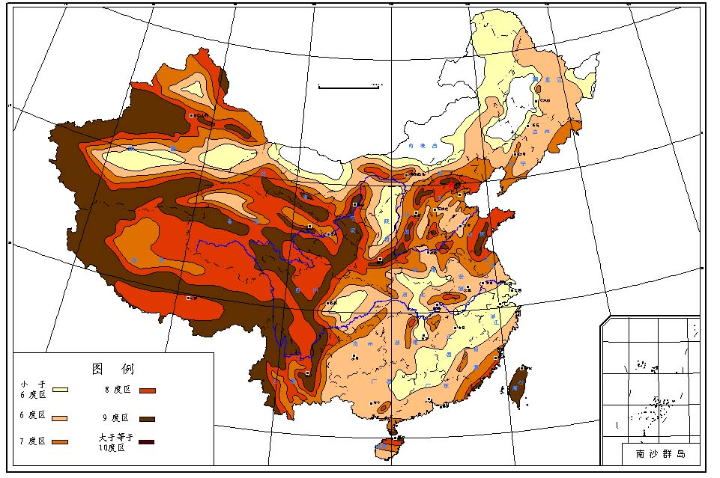
Seismic Hazard Analysis
Seismic Hazard analysis is aimed at giving the probability of the ground motion parameter over a certain value in a region.
China earthquake data center

Slide 3
Advances in Pricing Catastrophe Bonds informed by Earthquake Simulation Models
Quantitative assessment of strong earthquake hazard in fault zone
Property risk assessment of earthquake
Seismic wave propagation in complex 3D geologic body and ground motion simulation
Regional seismic hazard assessment, and rebuilding of seismic hazard map
Pricing model for insurance company
Property status assessment of insurance company
Vulnerability assessment of structures

Slide 4
Seismic Hazard Analysis—Step 1
Find the potential
Strong earthquake sources around the research region
Potential source

Slide 5


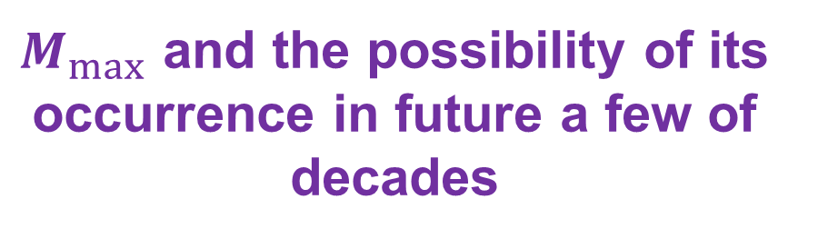

Seismic Hazard Analysis—Step 2
Estimate the Maximum magnitude and its average re-occurrence time for each potential source
$$S$$
$$f_{R}\left(r\right)$$
$$E_{j} f_{M}\left(m\right)$$
$M_{max}$ and the possibility of its occurrence in future a few of decades

Slide 6
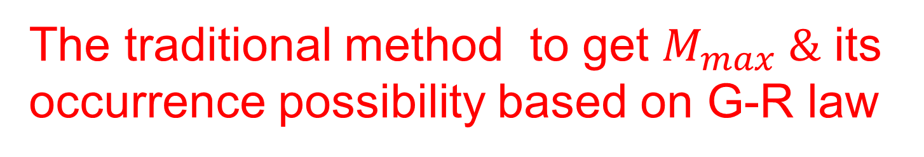
The traditional method to get $M_{max} \&$ its occurrence possibility based on G-R law

Slide 7
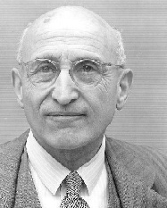

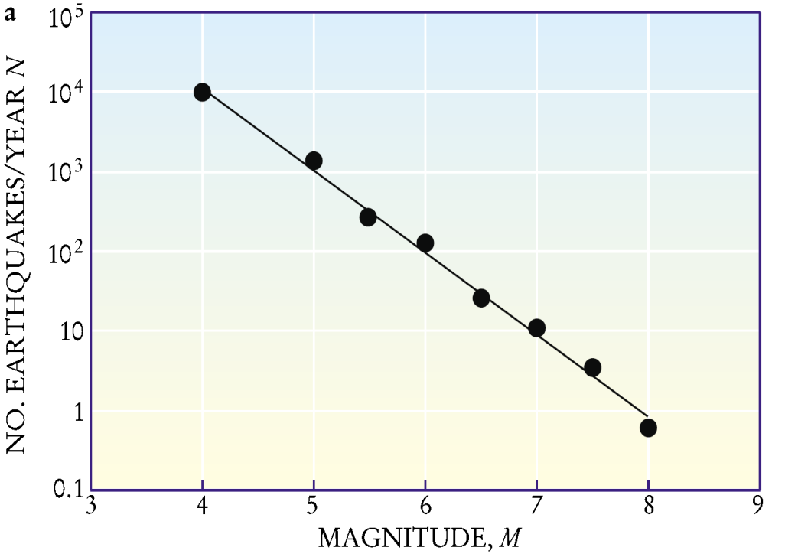
Gutenberg-Richter Law
M−N Statistics Word-wide
(N is the number of the earthquakes with Mag.>=M)
(Earthquakes from 1904 to 2000 by Kanamori et al., 2001)

Slide 8
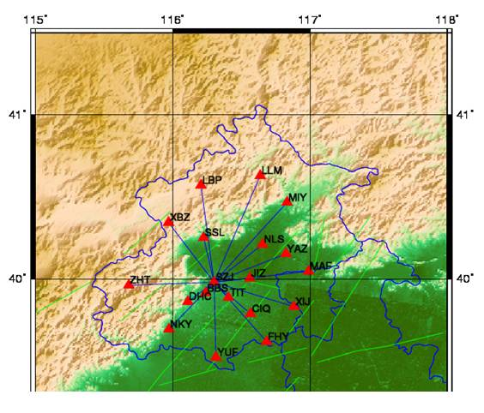

The destructive earthquakes have few of recordings on most of faults in the worlds since re-occurrence time of the strong earthquakes in a given region is generally between a few of decades to hundreds of years.
b=0.8582
The $M_{max} \&$ its occurrence possibility is usually extrapolated from the intrumental earthquake catalogue in earthquake engineering.

Slide 9
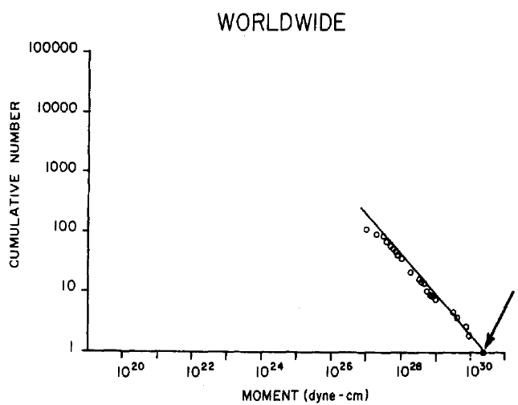
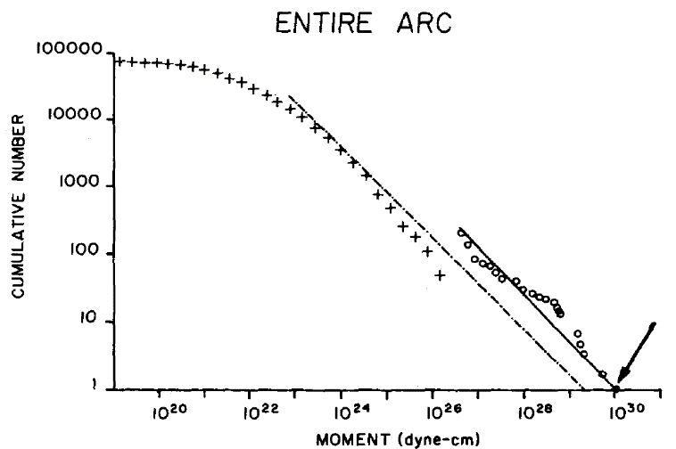
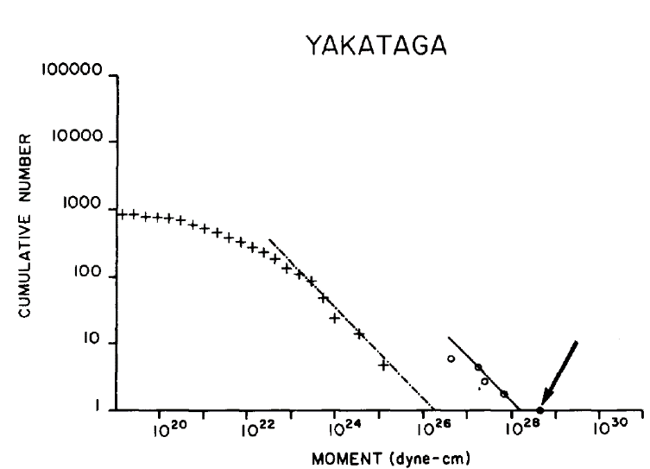
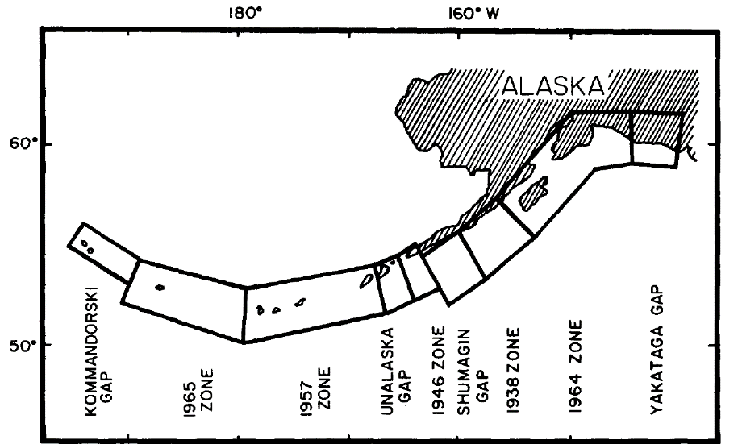
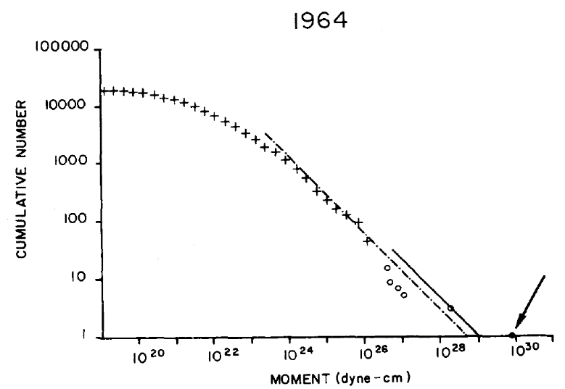
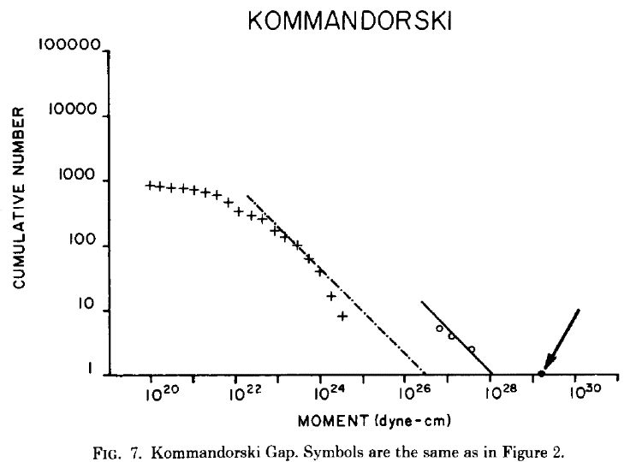
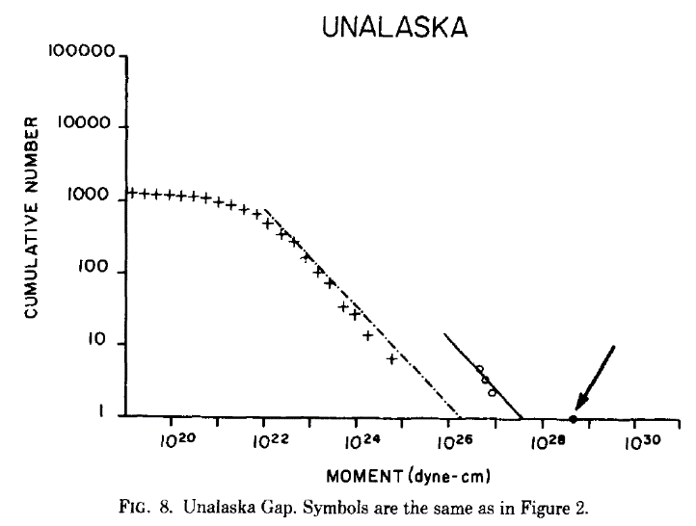
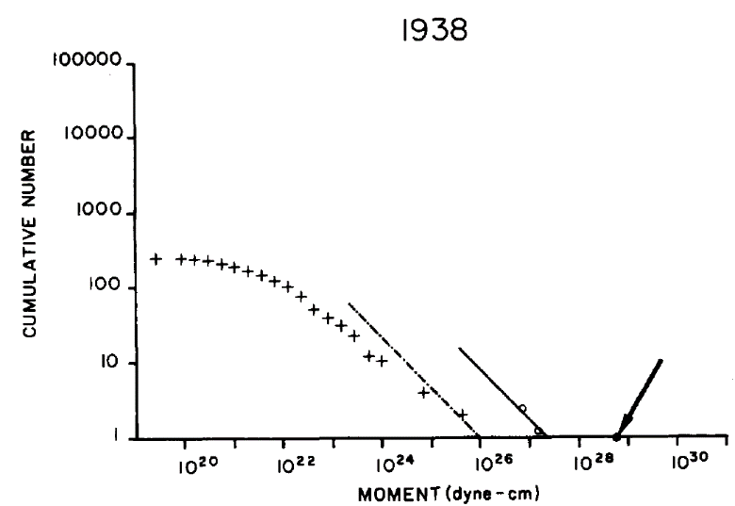
(Figures from
Davison & Scholz, 1985, BSSA)

Slide 10
玉田地震
汶川地震
Frequency and Magnitude Relation obtained by Yutian area earthquake data
Frequency and Magnitude Relation obtained by Wenchuan area earthquake data
玉树地震
The case that the Mmax might be
underestimated from the extrapolation of
the smaller earthquakes based on G-R law
Wang and Zhou, 2011
Frequency and Magnitude Relation obtained by Yushu area earthquake data

Slide 11
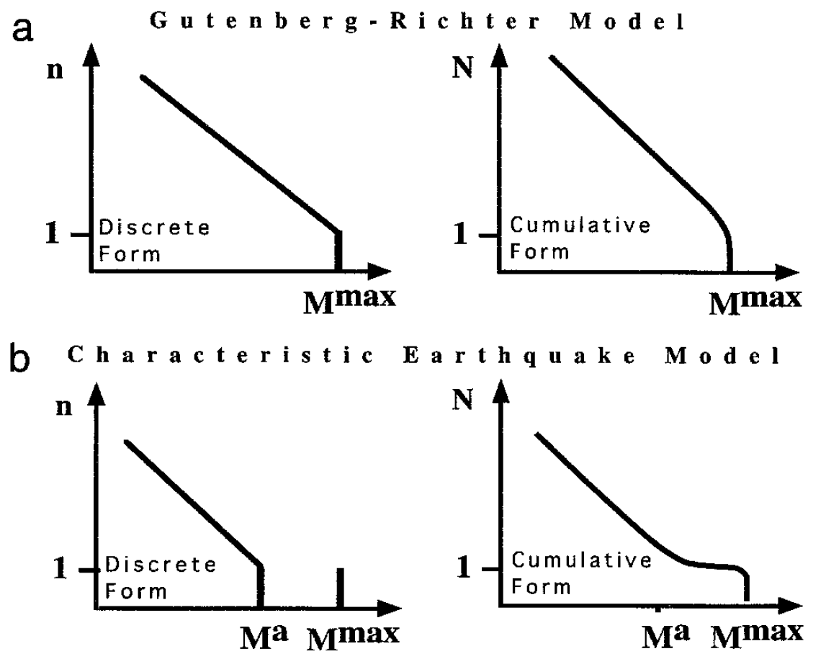
The case that the Mmax might be
overestimated from the extrapolation of
the smaller earthquakes based on G-R law
(from Wesnousky, 1994)

Slide 12

So the $M_{max}$extrapolated based on
G-R law is unreliable.

Slide 13

Could we directly get $M_{max}$by historical earthquake catalogue established based on historical document recordings or geological survey?
The historical catalogue is not complete (some may be missed ) and the magnitudes are quite uncertain.
In fact, some destructive earthquakes like Tangshan Ms7.8 earthquake (1976, killed more than 220,000) and Wenchuan Ms8.0 earthquakes (2008, killed more than 80,000) occurred in the areas where no strong earthquakes had been recorded in historical catalogues and had been generally considered as the safe areas by seismologists.

Slide 14
Why Seismicity Simulation ?
Modern seismic catalogue is too short for finding the potential strong shock sources completely.
Historical seismic catalogue is of too much uncertain.

Slide 15
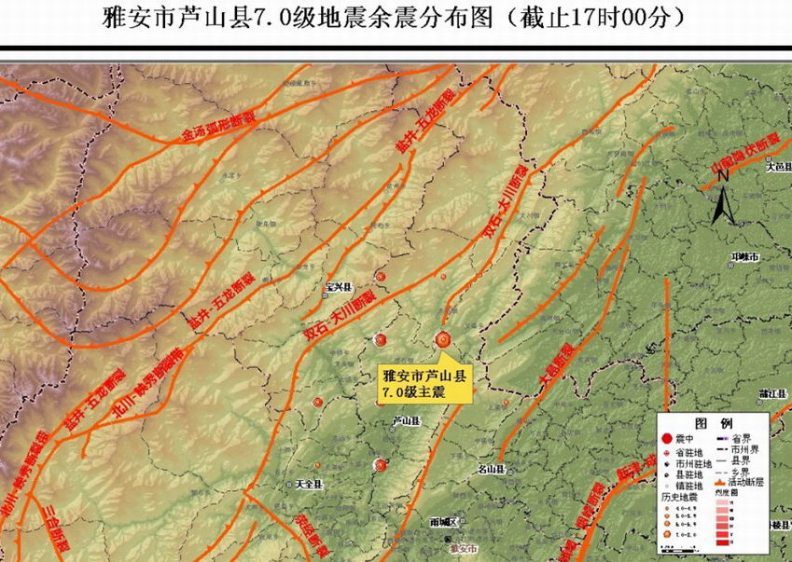
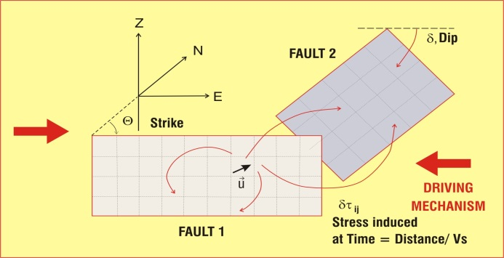
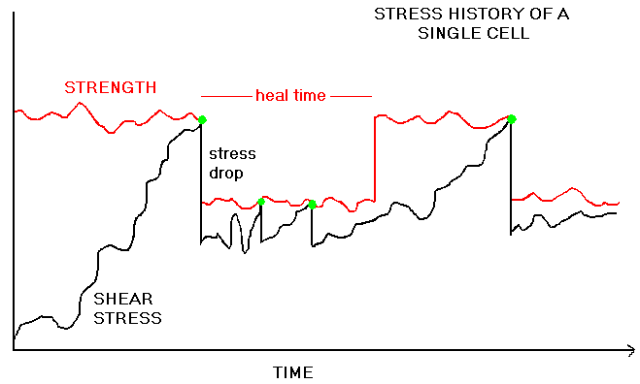
Seismicity Simulation Based on Tectonic Loading and Fault Interactions
Estimate the most danger fault (Biggest Possibility) and the possible maximum magnitude in a region
Rupturing Procession
Methods
Zhou S.Y. et al., 2005, GRL; 2005, BSSA; 2006, JGR;
地球物理学报 2008；
BSSA, 2010; GJI, 2012

Slide 16
Synthetic Seismicity:
Computer model of a network of interacting faults and a driving mechanism.
Generates long catalogues of seismicity so that questions can be answered by statistical analysis.
Get the rupturing processions of the simulated shocks.

Slide 17
Application Case

Slide 18
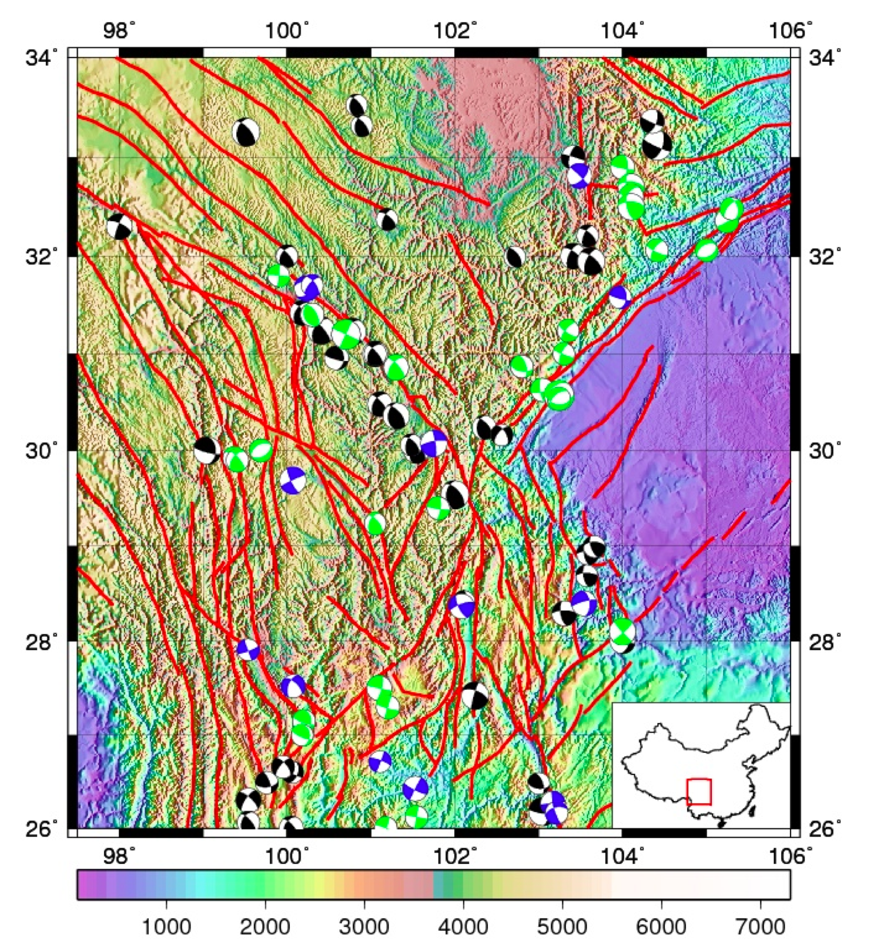
建立川滇地区的公共断层和公共速度模型

Slide 19
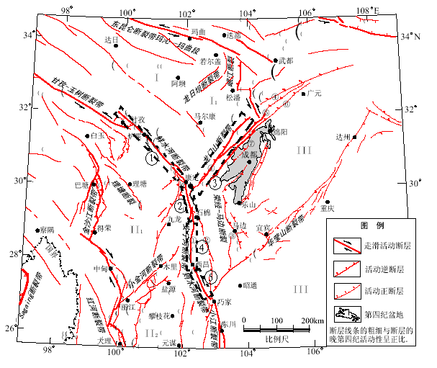
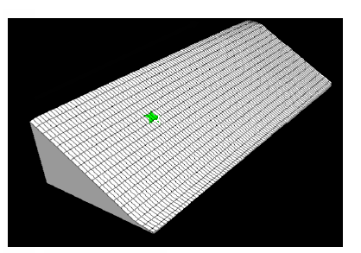
Quasi-static synthetic seismicity Model
From Xu et al., 2005

Slide 20
Quasi-Static Synthetic Seismicity Model
Assumption
Shear deformation or stress load rate ρ on an individual fault represents the external tectonic effects
There are static stress trigger due to some earthquakes.
Coulumb Fail Law:

Slide 21
How the Cells are loaded toward failure
Driver
Kss,Ksd,Kds,Kdd could be calculated with elastical theory
Resistance

Slide 22
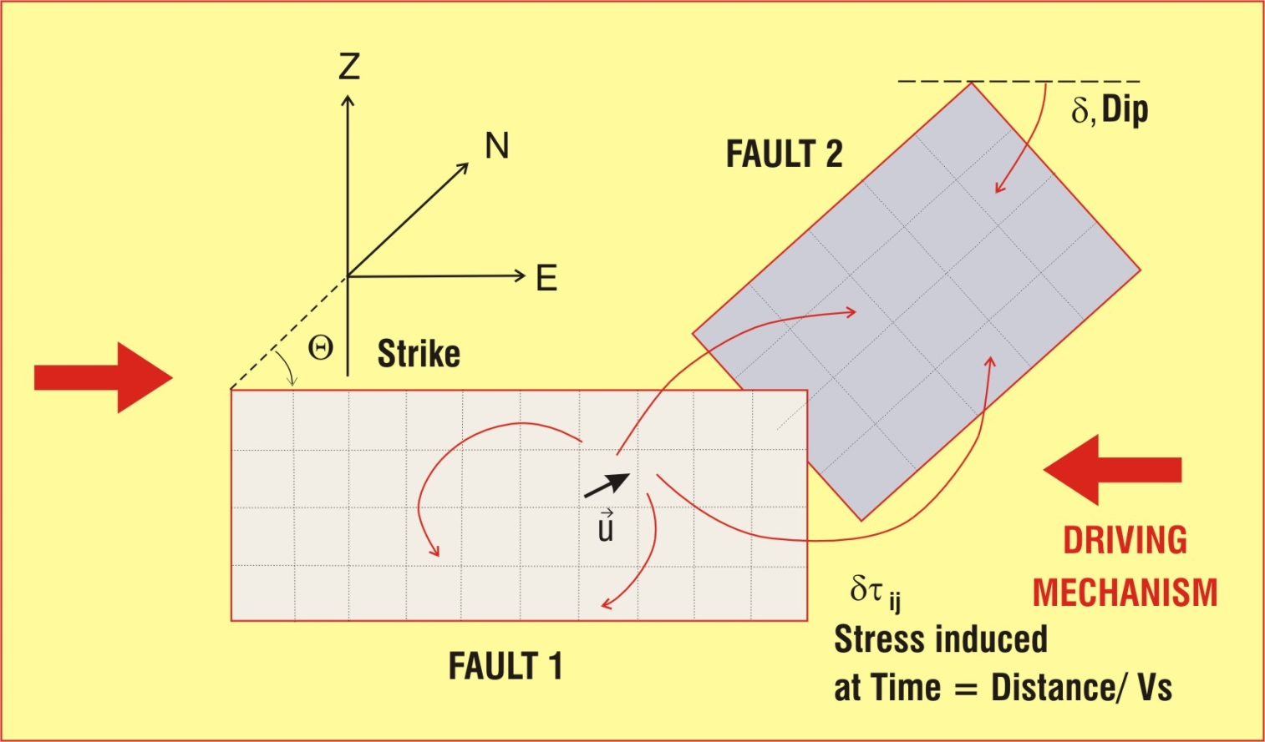
Calculation of the induced stress
(Okada,1992)
And Hooke’s law

Slide 23
Stress history of a single cell
Dyn
arr

Slide 24
How to get the times, locations and magnitude of earthquakes
Using the formula to solve when and which cell will satisfy “Coulumb Fail Law” firstly. The time marks the beginning of an “event: and the location of this cell marks the nucleation point of this event.
Check if there are any other cells to be induced to fail by the failing cell on the same fault
The slip of a failure is inferred from the stress drop by Okada’s formulation. Magnitude of this event is estimated from all slips of all failure cells during this event.
Where G is shear module, A is the area of a cell
Slip u is inferred from stress drop=τ-arr * S_{static}

Slide 25
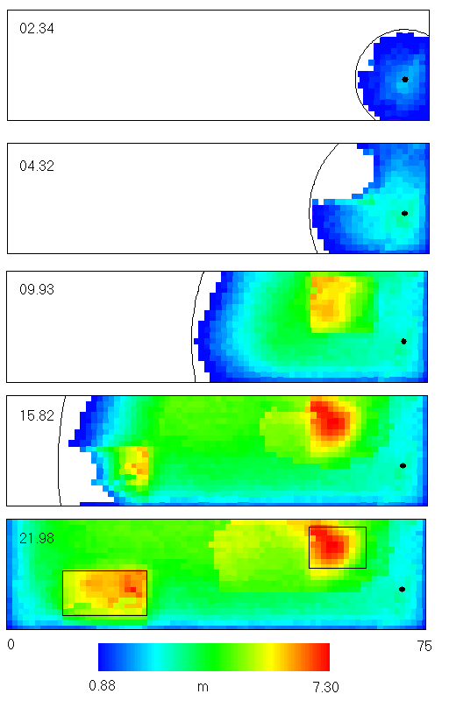
Rupturing
‘snapshots’ for a characteristic
Fault event

Slide 26
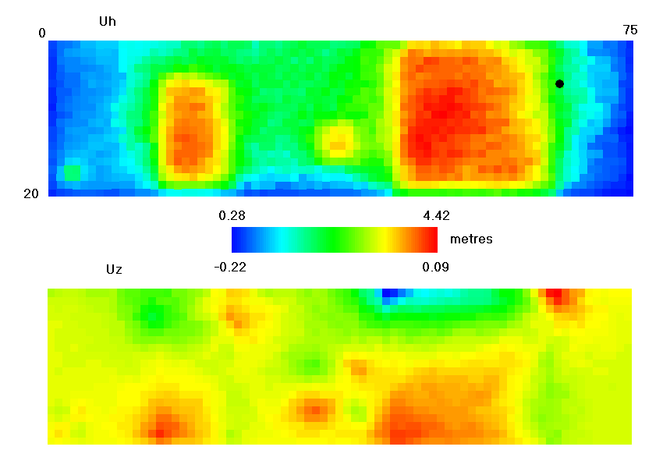
Final slip distribution

Slide 27
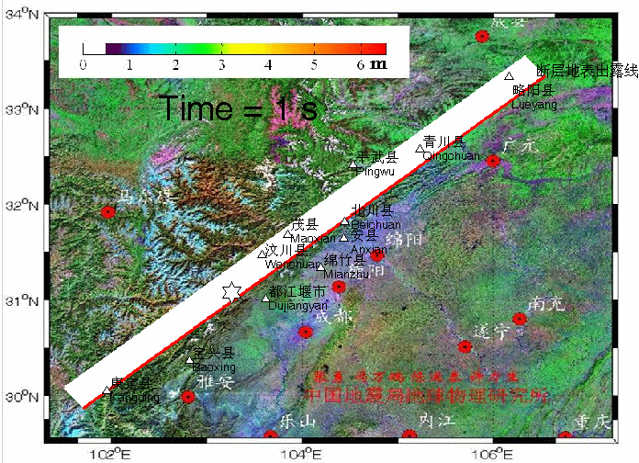

Slide 28
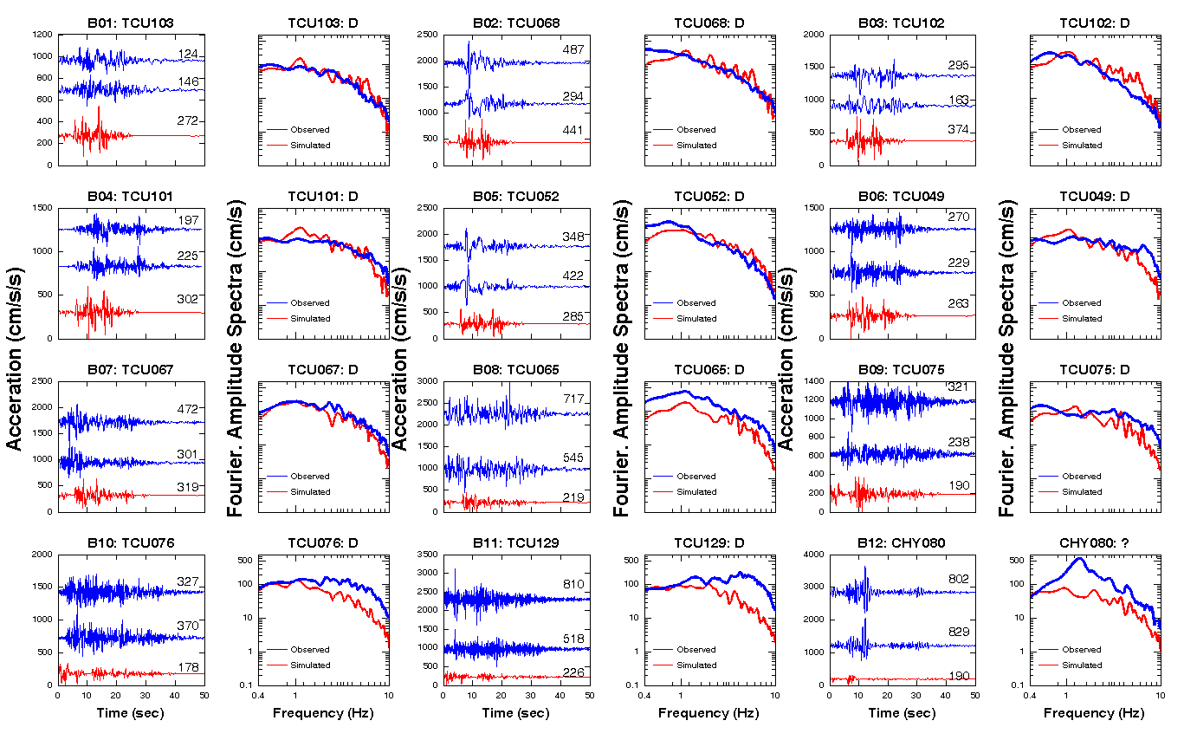
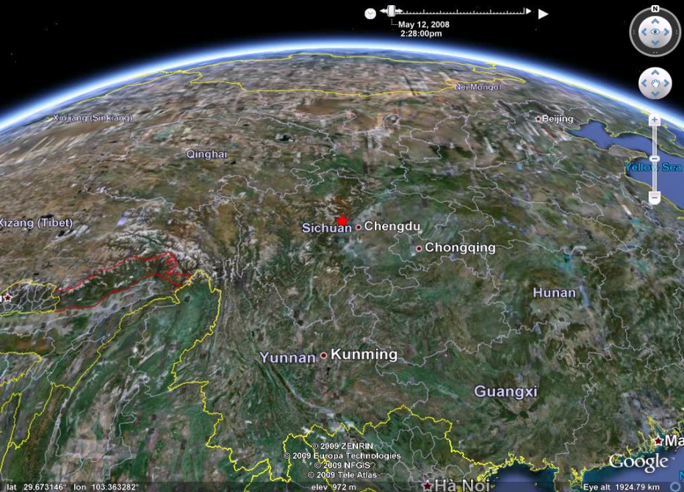
Also Simulate the Ground Motion and waveforms

Slide 29
Fault model

Slide 30
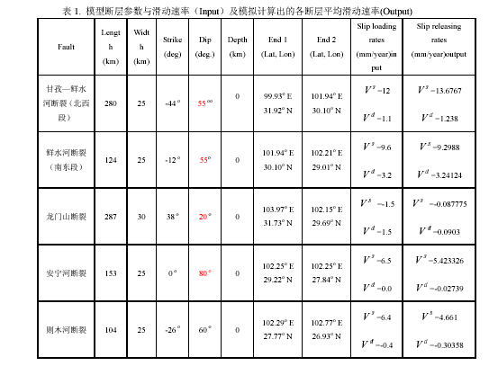
Parameters of the faults in the model
参数取值主要参照：徐锡伟等，2005；唐荣昌等，1993）

Slide 31
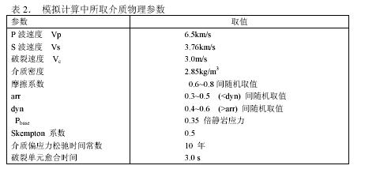
Physical parameters of the media in the model

Slide 32
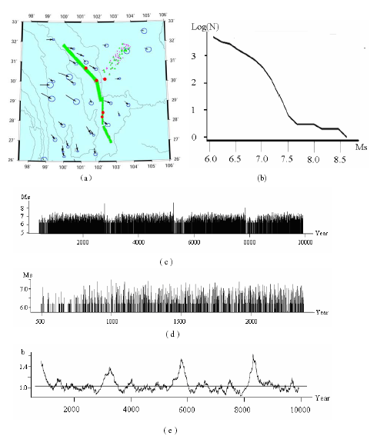
One of the simulations for 10000y in Western Sichuan

Slide 33
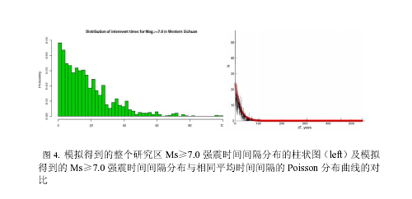
10 simulations with 10 different random seeds. The synthetic catalogue length for each simulation is 10,000 years. Sum up the 10 simulated catalogues, we got the interval distribution for Ms7.0 with total 4541 samples.
Figure 4 shows the occurrence of Ms≥7.0 shocks in western Sichuan is rather random, which is very close to the Poisson process with λ=0.0454a-1. It’s not a good news for Earhtquake prediction since Poisson event is unpredictable. We can not judge the risk increase or decrease from the time of the last shock. But it’s still meaningful for earthquake engineering for that the strong shock possibility for long-term ( tens of years) could be estimated well with Poisson model.

Slide 34
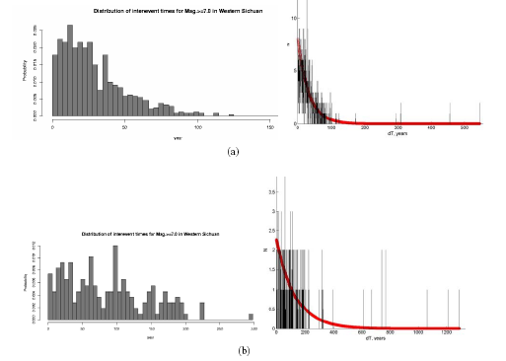
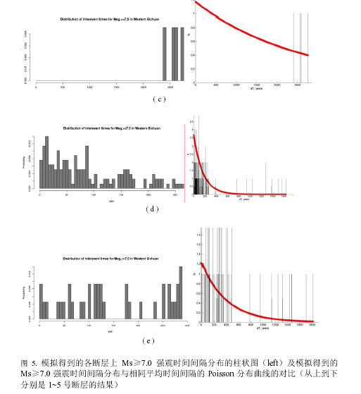
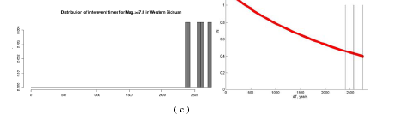
Fig.5 shows the interval distributions of the strong shocks fault by fault. It shows the interval distribution on an individual fault is far from a Poisson model, which means the occurrence of Ms≥7.5 strong shocks on an individual fault is not random and could be fitting with time-dependent predictable model. It’s a good news and also meaningful for earthquake engineering. It tells us that Poisson might not be a suitable model for estimate the shock risk for an individual fault research.

Slide 35
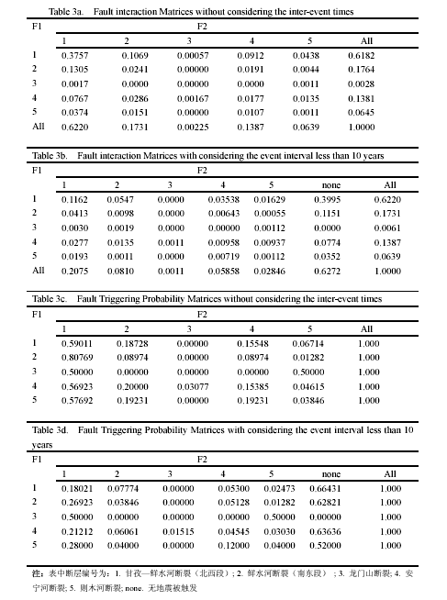
F1“Inducer fault” ，
F2 “Induced fault”
Table3a,3b show the Possibility distriution of the trigerred event-pairs on the faults.
Table 3c,3d show the Shock transfer possibility matrix from the inducer fault “ to “Induced fault “
Table3a,c do not consider the relax time (10 years)

Slide 36
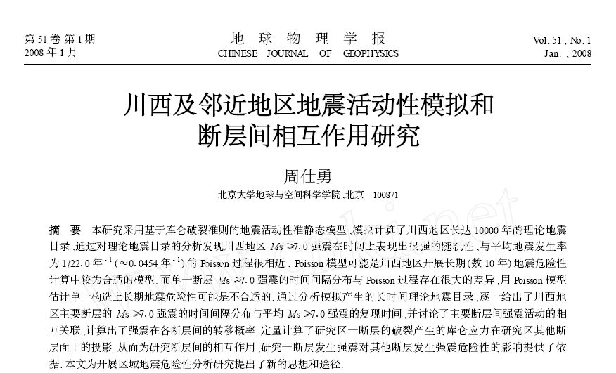
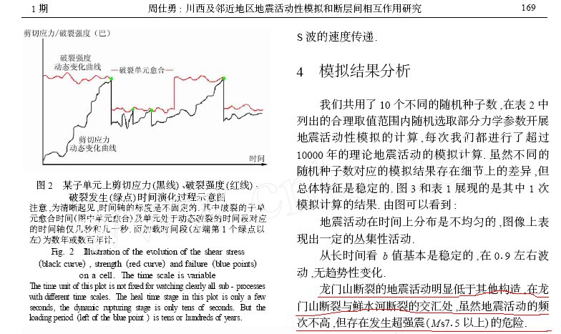
The figures show:
1）Seismicity on time is imhomogeneous，There are some clusters on M—t chart.
2）b value is stable from the sight of long-term tendency It flucates about 0.9. There is no tendency variation。
3）The seismicity on Lenmenshan fault is obviously lower than that on other faults. But the risk for super-strong shocks （Ms7.5) is still high comparing with other faults.

Slide 37
Features (1):
Coulomb Failure Criterion.
Static/dynamic friction law, including cell healing.
Okada’s (1992) dislocation routines for calculating induced stresses.

Slide 38
Features (2):
Induced changes in pore pressure are included.
Mimics dynamic rupture effects to some degree.
Stress propagation is at the shear wave velocity.

Slide 39
In earthquake engineering，The seismicity rate λ of the strong earthquakes ( such as Ms>7.0) on a fault is a key parameter in the calculation of the earthquake occurrence possibility with Possion model
Time-Independent Prediction Model

Slide 40

Sunset in Tibet
Thank you for listening!

Slide 41
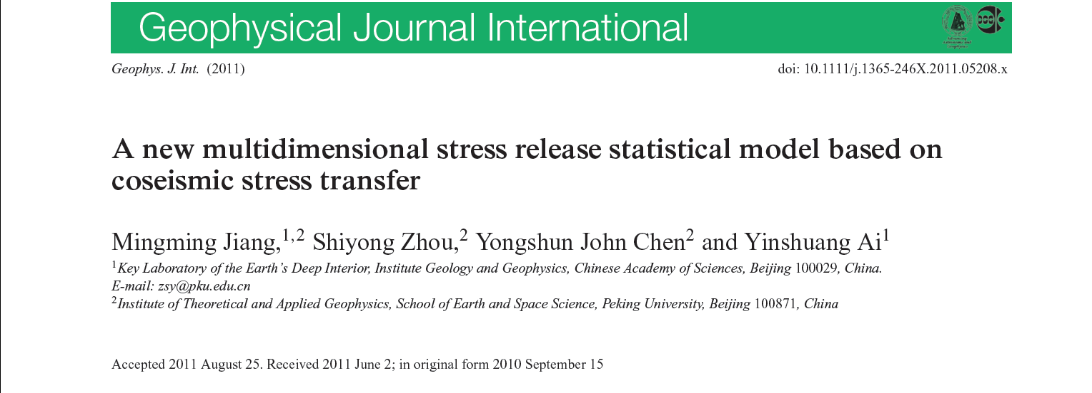
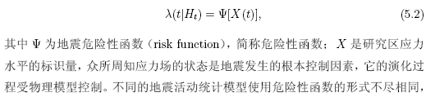
2. Stress Release model and its application in seismic hazard assessment
条件概率强度（conditional intensity function）
条件概率强度作为点随机过程的控制函数，在统计预测模型中，需要建立条件概率强度与地震物理量的函数，即危险性函数（hazard function）。

Slide 42
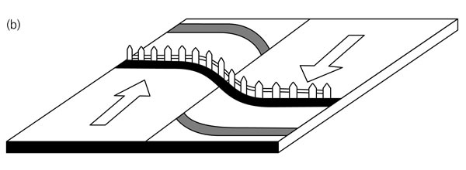
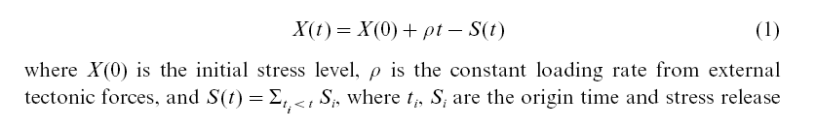

SRM (Vere-Jones,1978) is a non-stationary Possion Model based on the elastic rebound hypothesis (Reid, 1910)
Time-dependent Prediction Model（SRM & MSRM）
SRM could basically be proper for a region with a single fault. It’s a time-predictable model for Earthquake hazard.

Slide 43
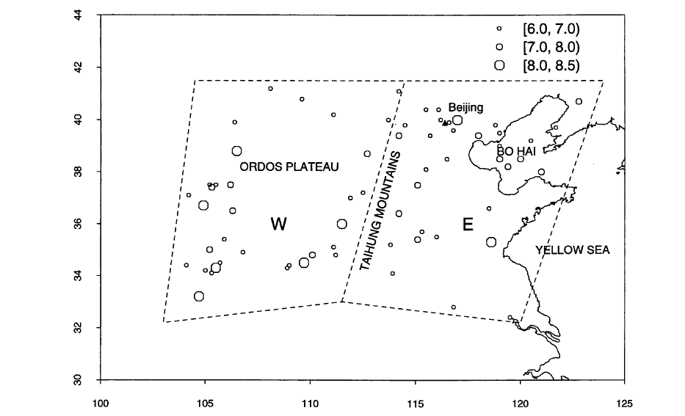

CSRM (Liu et al.,1999;Bebington, 2003) tried to extend SRM to a complex region with a few sub-tectonic regions
CSRM is not a real Space-time earthquake hazard prediction model
Two difficulties:
How to divide the region into sub-regions reasonably?
How many sub-regions should be divided to ? The more subregions , the more model parameters. Enough data support to construct CSRM model with many parameters ?

Slide 44
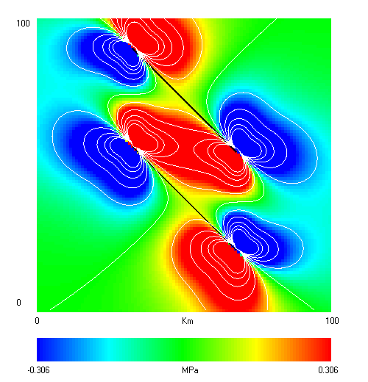
Non-stationary Possion Model
Stress release model
Coupled stress release model
Is it the real situation that the stress will all release in a region with a few faults after one earthquake?
depends on mechanisms

Slide 45
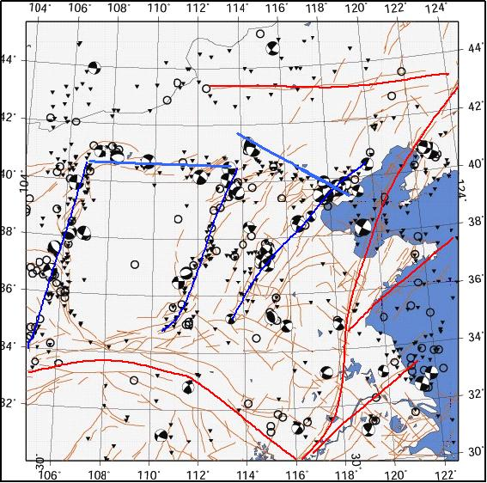
To extend SRM to a real Space-time prediction model
What is the nature of the SRM hazard function ?
How can the stress level in SRM be represented correctly ?

Slide 46
Evidence from the laboratory
In static fatigue studies, the data are generally reported as the mean fracture time <t> (Scholz, 1968)
The risk function of stress release model
real stress
Num. of the events per time unit

Slide 47
Conclusions 1
The hazard function could be an expression of the static fatigue in the crust
The stress level X in the hazard function could be the real stress

Slide 48
Upgrading SRM with the co-seismic stress triggering model
the induced shear stress on the fault plane due to earthquakes

Slide 49
How to get g(x,y)
On the long-term, the stress accumulation and release should keep balance for a region, so we can verify:
The spatial weight function of our model could be inferred from the spatial distribution function of the regional long-term average seismicity or described by the spatial distribution of the regional background seismicity

Slide 50
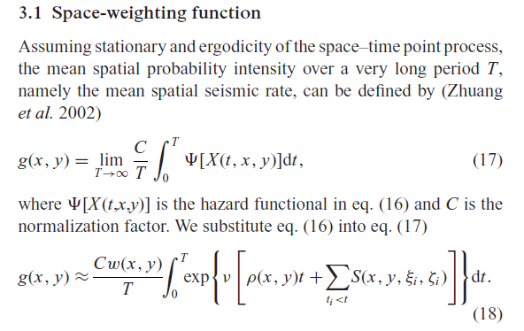

Slide 51
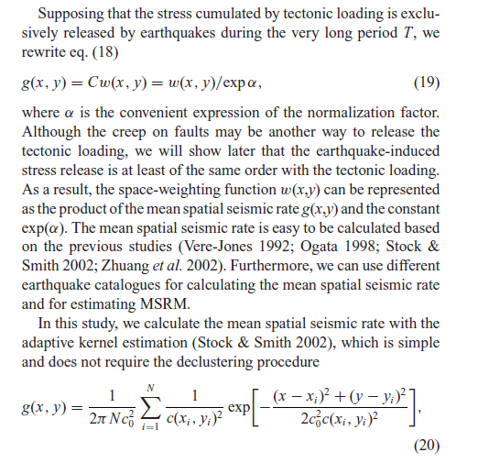

Slide 52
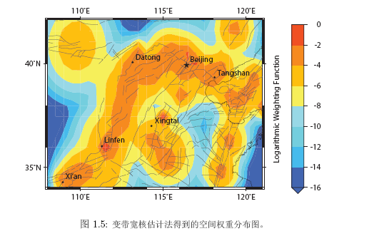
g(x,y) inferred from the seismicity data

Slide 53
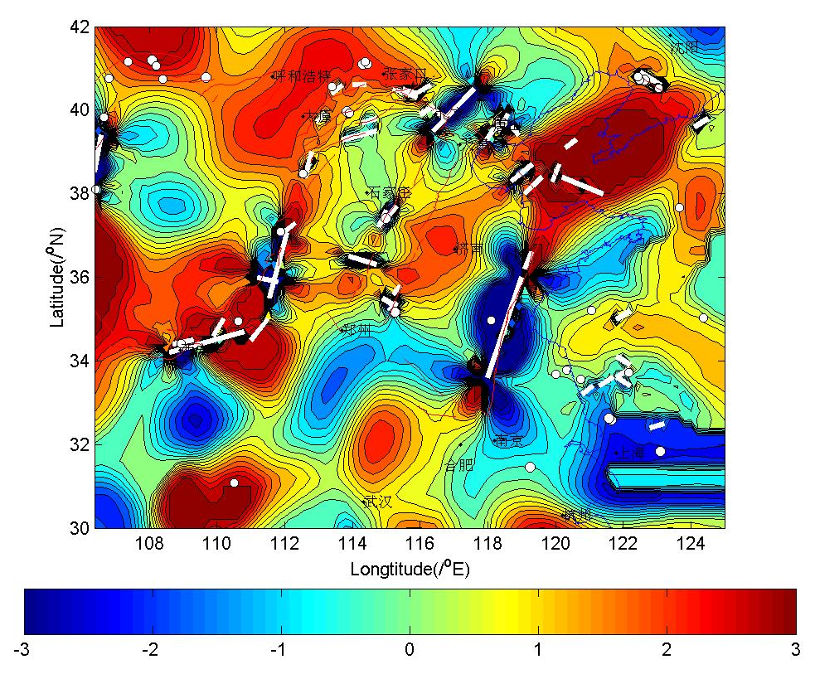
How to get ?
The procedure of Okada (1992, based on static displacement field of the elastic medium triggered by a slip) was used to get induced shear stress

Slide 54
How to get the loading term
N
ρ(x,y)
azimuth=16.5°

Slide 55
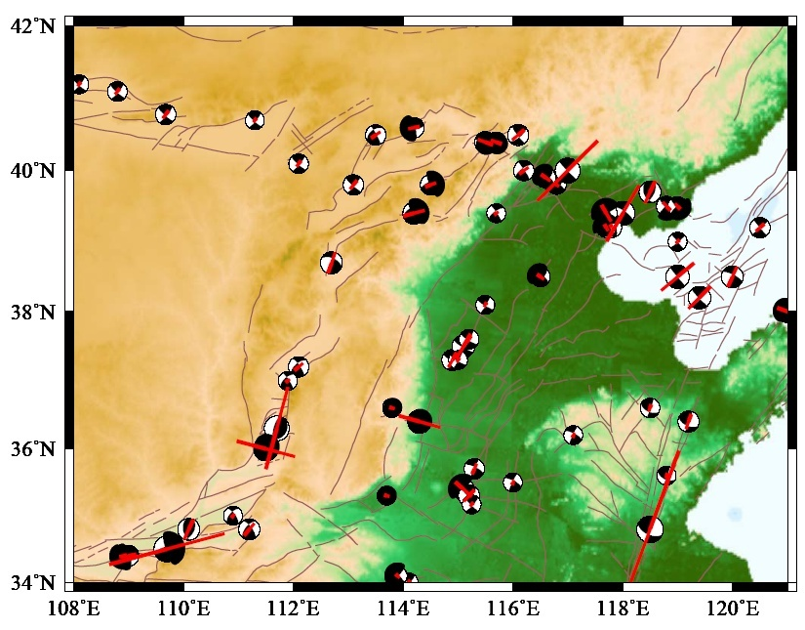
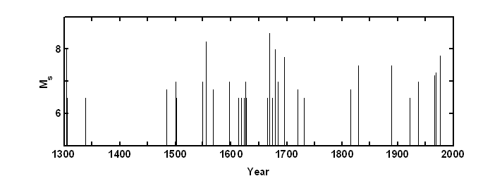
Historic catalogue from 1300 to 1997 in North China
M_{s}≥6.0
64 events
M_{s}≥6.5
37 events

Slide 56
The parameters to be fitted in the model
The normalization factor α
The stress impacting factor ν
Main stress azimuth θ of the regional tectonic stress
2 regional tectonic loading rate ρ ( Main Strain rate)

Slide 57

Fitting results

Slide 58


Be extended to spatial-time domain

Slide 59
The variation of conditional intensity with time

Slide 60
AIC | AIC_{SRM} | ΔAIC_{S} | AIC_{Poisson} | ΔAIC_{P}
563.70 | 583.88 | 20.18 | 586.00 | 22.30
Be extended to spatial-time domain

Slide 61
Results more than the classic stress release model
We can get the spatial distribution of the conditional intensity at any time

Slide 62


Slide 63
Some examples before or after some super shocks in history

Slide 64


Slide 65
Conclusions 2
The multiple dimension stress release model could be got based the multiple dimension physical model instead of the simple physical model.
The spatial distribution of the conditional intensity could be very useful in the hazard analysis, if it could be express in a proper way.
Fitting data better than the classic SRM (lower AIC)
The additional sorts of data are needed besides the traditional catalogues. These data can be easily got in modern catalogues, but the problem is the modern catalogues are not long enough.

Slide 66
Sunset in Tibet
Thank you for listening!

Slide 67


Slide 68


